Slide 1
Pre-Thesis: Application of sentimental analysis in adaptive user interfaces
Badruddin Kamal;
Supervisor Abu M. Hammad Ali;
Co-supervisor Dr. Mumit Khan;
BRAC University,Dhaka, Bangladesh;

Slide 2
Objective
Collect textual Dataset from user.
Determine the mood using sentimental analyzer.
Apply appropriate design and layout and content changes depending on the subject’s mood.

Slide 3

Why do this?
We are increasingly spending a large amount of time online and on our devices.
Generating data about ourselves.
Avg ameriacn 6hrs daily on social networking and hours going up.

Slide 4
An example
Suppose a user is in a bad mood so does a set of actions like closes and opens pages for long periods, suggest's a friend their feeling bad etc.
Our software will collect all this data from their actions, chat etc . and determine their mood is bad
Then it will take some predetermined set of actions to make the user’s mood better like suggest mood cheering up application’s like Facebook LifeBox, Stimulate conversation with people likely to better their mood like friend's etc by suggesting them in wall posts more , change the layout etc.
Much like iGoogle but automatic triggered by user sentiment

Slide 5
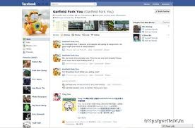
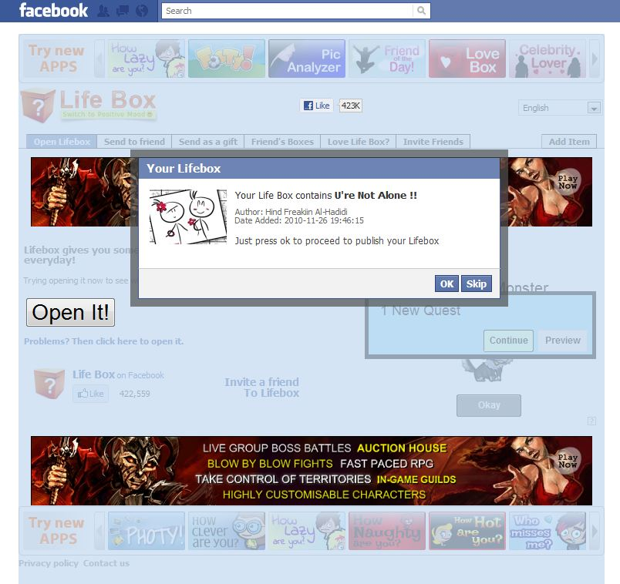
Example

Slide 6
What’s the plan?
Collect user data from online site to train Sentimeantal Analyzer.
Train a Sentimental analyzer created in python NLTK.
Create a demon to collect user data.
Apply appropriate layout and content changes depending on the mood.

Slide 7
Sentimental Analyzer
For the experiment we will use a text based sentimental analyzer.
For this we will collect data from an online site ie. Fb wall/ blogposts.
Train the analyzer to determine positive and neutral and negative moods.
Example:-http://text-processing.com/demo/sentiment/

Slide 8
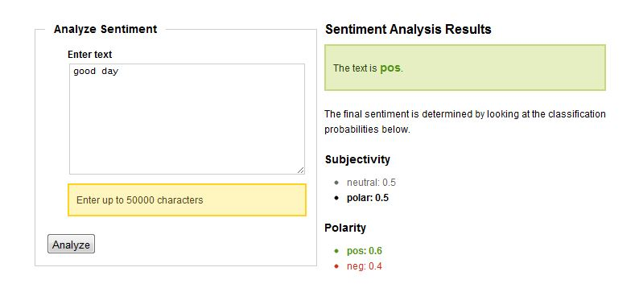
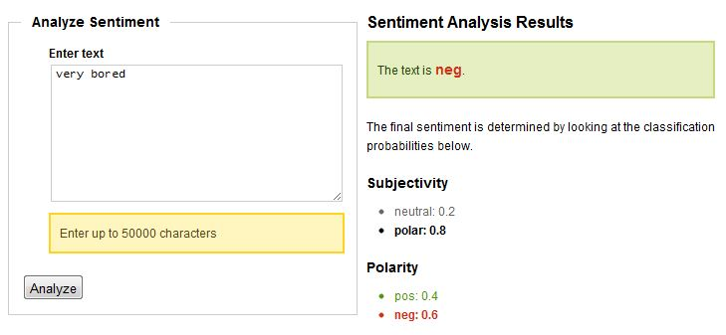
Example

Slide 9
Adaptive Interfacing
After collecting the user sentiment ,we determine a few set of actions to do.
User =>Negative Take actions to change layout, Content, Background etc.
User =>Positive , Neutral ,Take no action.

Slide 10
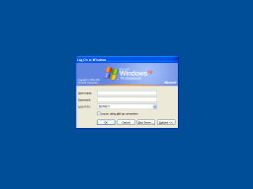

Examples,content change typical to better mooded.

Slide 11
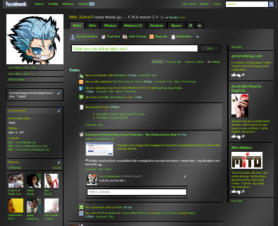
Examples,content change typical to better mooded.

Slide 12
Some data from research
Twitter status sentiment suggests
bigram tokenizer’s perform better than unigrams.
Social network analysis plays part in this but for the sake of simplicity ,will be avoided.
Dataset should avoid biasing.
Close to 80% will be good enough to be close to human’s own cpacity of Sentiment analysis.
Smiley’s ☺ :( etc. must be processed and word’s may not be complete such as plz, sud etc.

Slide 13
Question’s?
☺ ☺ ☺

